Slide 1
CS 7172 Parallel and Distributed Computation Remote Procedure Calls
Kun Suo
Computer Science, Kennesaw State University
https://kevinsuo.github.io/

Slide 2
Outline
What is RPC and why we need RPC?
How RPC works?
Implementation details of local call and RPC
Examples of RPC
Remote Method Invocation (RMI)
Synchronous and asynchronous in RPC

Slide 3
Why Remote Procedure Calls?
The essence of distributed is multi-process/thread collaboration to complete tasks together
In order to collaborate, communication is inevitable
Remote Procedure Calls is one way for communication for processes in distributed systems

Slide 4
What is Remote Procedure Calls?
Order
Pay
logistics

Slide 5

What is Remote Procedure Calls? Example
Order
Order
finish
Local call
Payment
Pay for order
RPC
Payment finish
Order status update
Local call
deliver
Out of stock
RPC
delivered

Slide 6
Local call and Remote call
Local call usually refers to the mutual call between functions within the process
Remote call is the mutual call of functions between different processes
Remote call is one way of Inter-Process Communication (IPC)

Slide 7

Two categories of Remote Call
Local Procedure Call (LPC): communication between processes running on the same machine
Remote Procedure Call (RPC): communication between processes running on different machines ➔ Widely used in distributed systems

Slide 8
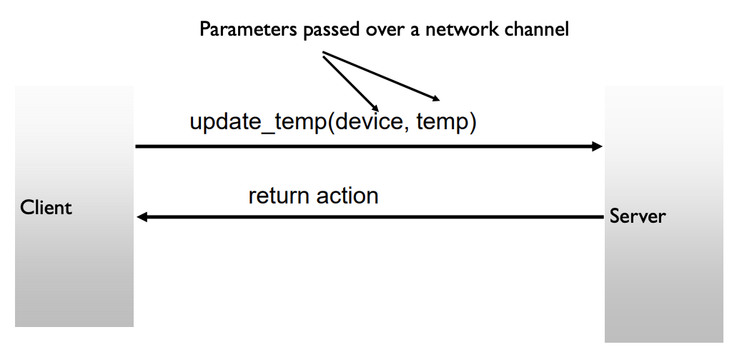
RPC Example

Slide 9
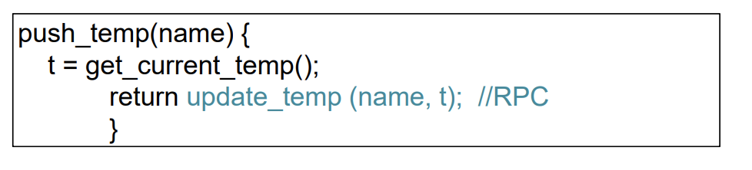
RPC Advantages
Clean and simple to understand semantics like local procedure calls
Generality: all languages have local procedure calls
RPC libraries augment the procedure call interface to make RPCs appear like local calls
Abstraction for a common client/server communication pattern

Slide 10
B/S Architecture
Browser/Server architecture: runs an application directly from an internet browser
The server side opens an interface and the client side uses browser to call the API to achieve remote call
Weather server

Slide 11
B/S Architecture
B/S Architecture is implemented by HTTP protocol
Every time calling the APIs, client needs to send HTTP request
Complex protocol, close to user level
Time-consuming, not suitable to low latency request in large-scale distributed system

Slide 12
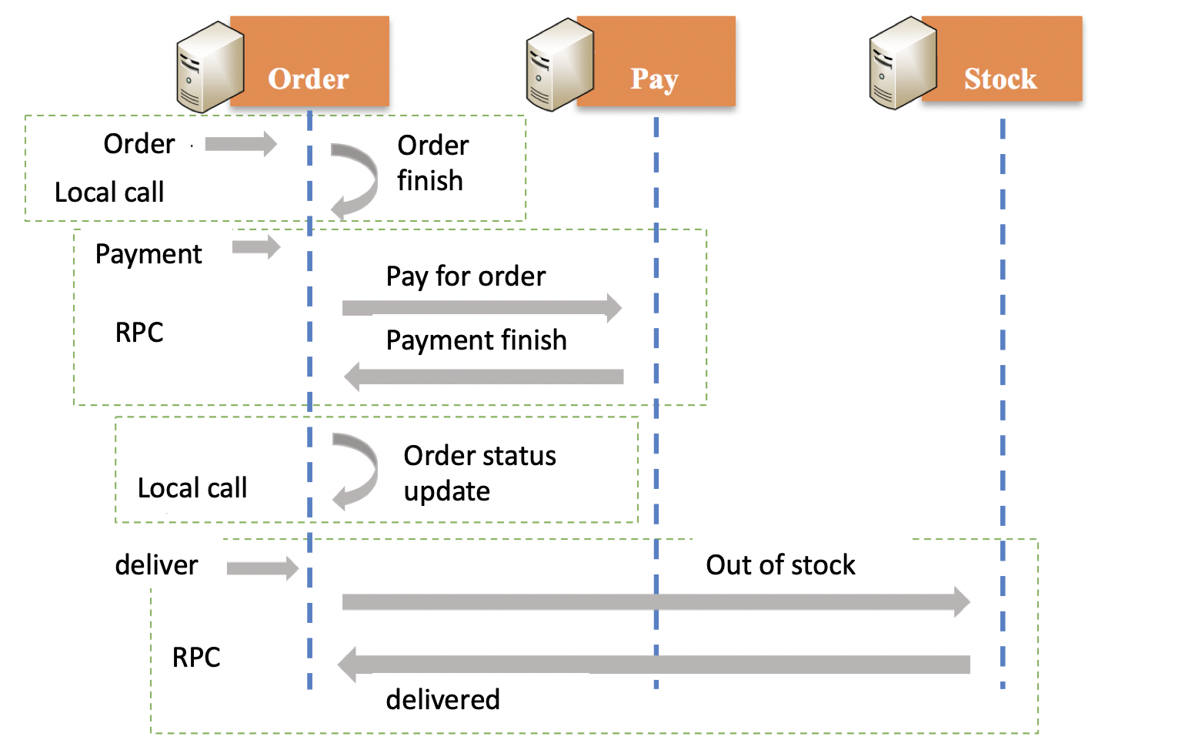
How RPC works?
The caller uses the parameter passing method to call a function on the local machine to execute the function on the remote machine and receives the return results

Slide 13
How RPC works?
Order system
Payment system
Local call
Local call
Call payment function
Client stub is used to transfer the passing parameter
System call
System call
Network call
Network call
OS Kernel
Networking
OS Kernel
Machine A
Machine B

Slide 14
Client And Server Stubs
Client makes procedure call (just like a local procedure call) to the client stub
Server is written as a standard procedure
Stubs take care of packaging arguments and sending messages
Packaging parameters is called marshalling

Slide 15
How RPC works?
Order system
Payment system
Local call
Local call
Client stub packages the function pay and parameter order into a message and sends it into kernel
Message is sent to machine B using network
System call
System call
Network call
Network call
OS Kernel
Networking
OS Kernel
Machine A
Machine B

Slide 16
How RPC works?
Order system
Payment system
Local call
Local call
Server stub unpacks the message and get the parameter
System call
System call
Machine B receives the message and sends it to server stub
Network call
Network call
OS Kernel
Networking
OS Kernel
Machine A
Machine B

Slide 17
How RPC works?
Order system
Payment system
Local call
Local call
Machine B finishes the pay(order) execution and sends results to server stub
System call
System call
Server stub packs the results into message and sends it into kernel
Network call
Network call
OS Kernel
Networking
OS Kernel
Machine A
Machine B

Slide 18
How RPC works?
Order system
Payment system
Local call
Local call
Client stub unpacks the message and returns it to local system
A receives the message from B and sends it to client stub
System call
System call
Network call
Network call
OS Kernel
Networking
OS Kernel
Machine A
The message is sent back to A through network
Machine B

Slide 19
How RPC works?
Order system
Payment system
Local call
Local call
Local call
System call
System call
Network call
Network call
OS Kernel
Networking
OS Kernel
Machine A
Remote call
Machine B

Slide 20
How RPC works?
From the user perspective, the RPC of pay(order) to remote machine is just like execution of the local call.
Order system
Payment system
Local call
Local call
System call
System call
Network call
Network call
OS Kernel
Networking
OS Kernel
Machine A
Machine B

Slide 21
Local call vs. Remote call implementation
Shared memory
Network passing
User use {ID + function + parameter} to do remote function call due to different memory space
Under the different memory address
Shared memory passing
User can use {function + parameter} to do local function call
Under the same memory address

Slide 22
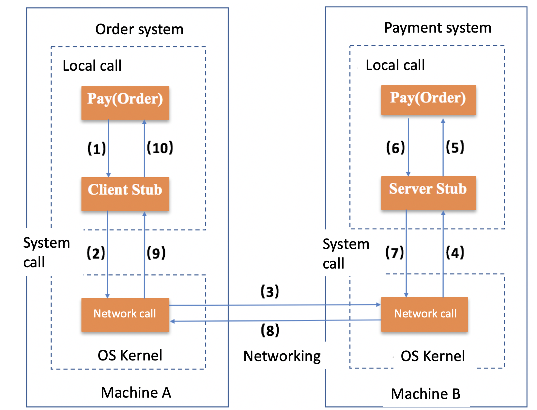
Local call vs. Remote call implementation
function | ID
pay | 111
cancel | 222
refund | 333
… | …
function | ID
pay | 111
cancel | 222
refund | 333
… | …
The ID is used to differentiate the function address under different memory addresses

Slide 23
Local call vs. Remote call implementation
Shared memory
Network passing (binary stream)
Cannot pass parameter type directly
The passing messages must be serialized and deserialized
Shared memory passing
Memory can store different parameter types (e.g., int, double, string, object, …)

Slide 24
Local call vs. Remote call implementation
Compared to the local call, the RPC messages must be serialized and deserialized

Slide 25
Local call vs. Remote call implementation
The RPC needs network transmission protocol for parameter passing and receiving
Most of the RPC uses TCP for the protocol
Network transmission protocol

Slide 26
Differences of Local call vs. Remote call implementation
Call ID and function mapping
Serialization and deserialization
Network transmission protocol

Slide 27
Potential Issues of RPC
1
2
3
4
A
B
C
D
Suppose we have n service providers and m service callers
The number of call relationship will be n*m, which makes the communication overhead too significant

Slide 28
Service Registration Center for RPC
1
2
3
4
Service registration center
A
B
C
D
Service providers register services on service registration center
Service callers visit needed services from service registration center
Such the design can reduce the communication volume significantly

Slide 29
Example: Apache Dubbo
Apache Dubbo™ is a high-performance, java based open source RPC framework.
http://dubbo.apache.org/

Slide 30
Example: gRPC
gRPC is a modern open source high performance RPC framework that can run in any environment. It can efficiently connect services in and across data centers with pluggable support for load balancing, tracing, health checking and authentication.
https://grpc.io/

Slide 31
A variation of RPC: RMI (Remote Method Invocation)
RMI is a Java-based application programming interface that enables objects running on the local Java virtual machine to call objects on the remote Java virtual machine as if they were local objects.
Order system
Payment system

Slide 32
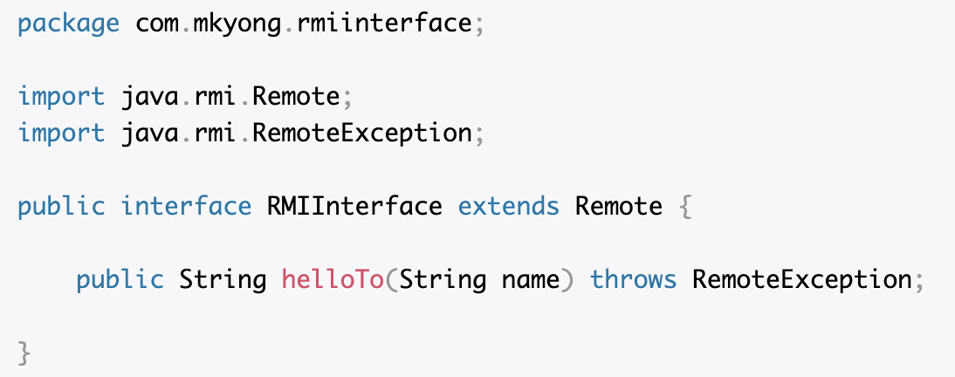
An example of RMI
RMIInterface has only one method;
it receives a String parameter and returns String.

Slide 33
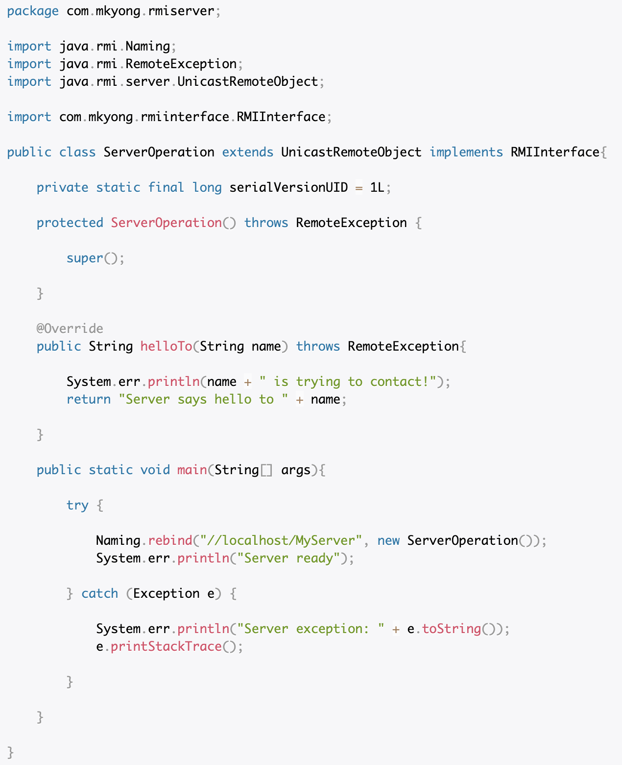
An example of RMI
Our Server extends UnicastRemoteObject and implements the Interface we made before.
In the main method we bind the server on localhost with the name “MyServer”.

Slide 34
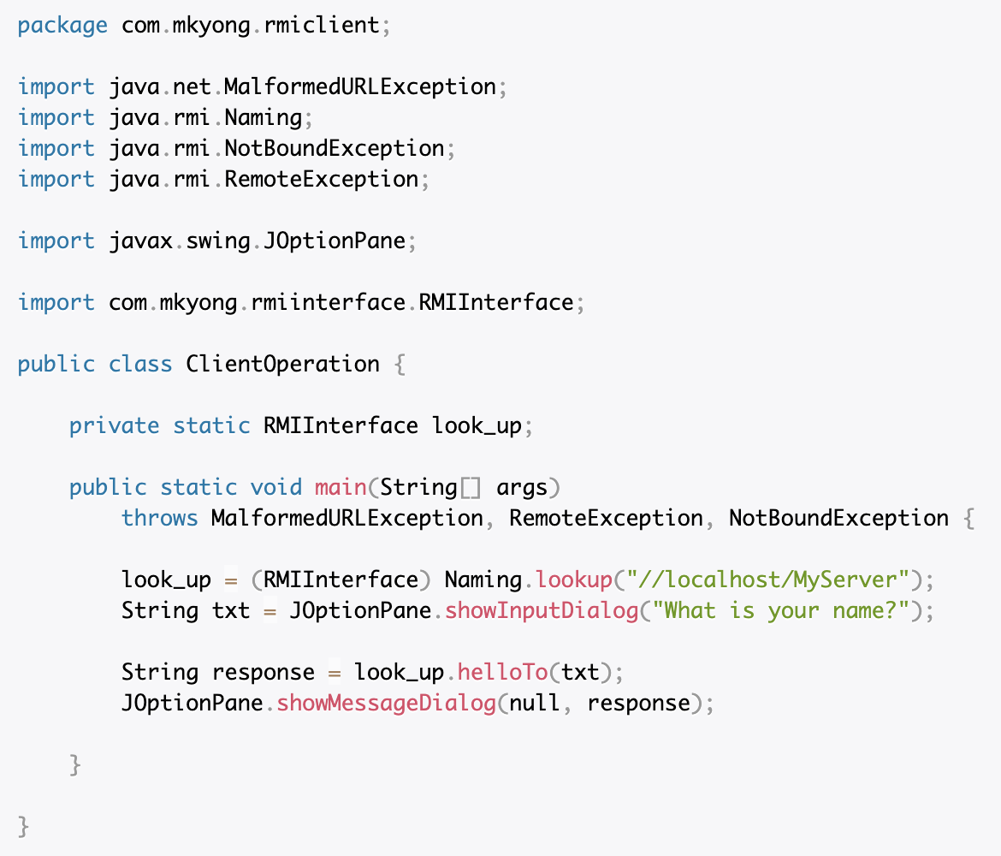
An example of RMI
the Client uses an RMIInterface Object that “looks” for a reference for the remote object associated with the name we pass as parameter
Remote call server side function helloTo()

Slide 35
An example of RMI
Client
Server

Slide 36
Synchronous vs. asynchronous call
Synchronous call: application is blocked until the operation finishes
Asynchronous call: application is not blocked and can does other tasks during the operation is processing

Slide 37
Synchronous vs. asynchronous call in RPC
Synchronous call: is used for requiring exact results or returning the results directly
E.g., weather
Asynchronous call: is used for high response efficiency but low exact return results
E.g., video decoding

Slide 38
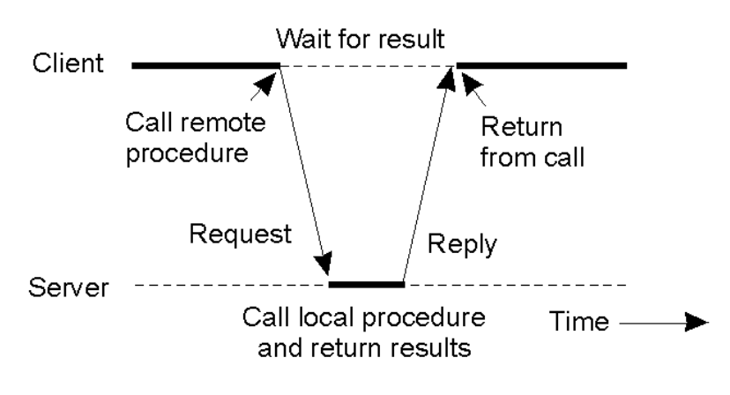
Synchronous vs. asynchronous call in RPC
Usually, RPCs are blocking
Thus, also useful for synchronization

Slide 39
Conclusion
What is RPC and why we need RPC?
How RPC works?
Implementation details of local call and RPC
Examples of RPC
Remote Method Invocation (RMI)
Synchronous and asynchronous in RPC

